Slide 1
Lecture 8
Recap
Quantum enhanced GP for Bayesian deep learning
More on state preparation

Slide 2
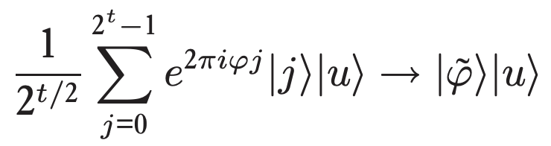
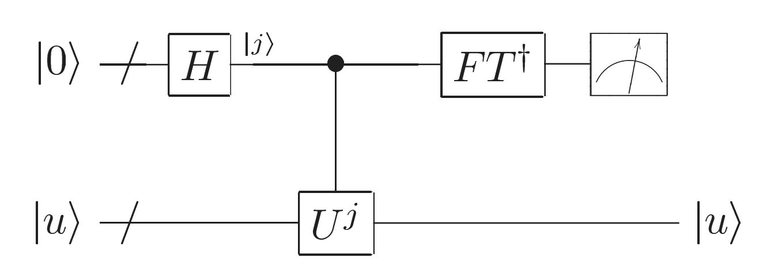
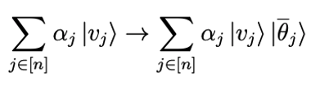
Recap: QPE
First register
Second register

Slide 3
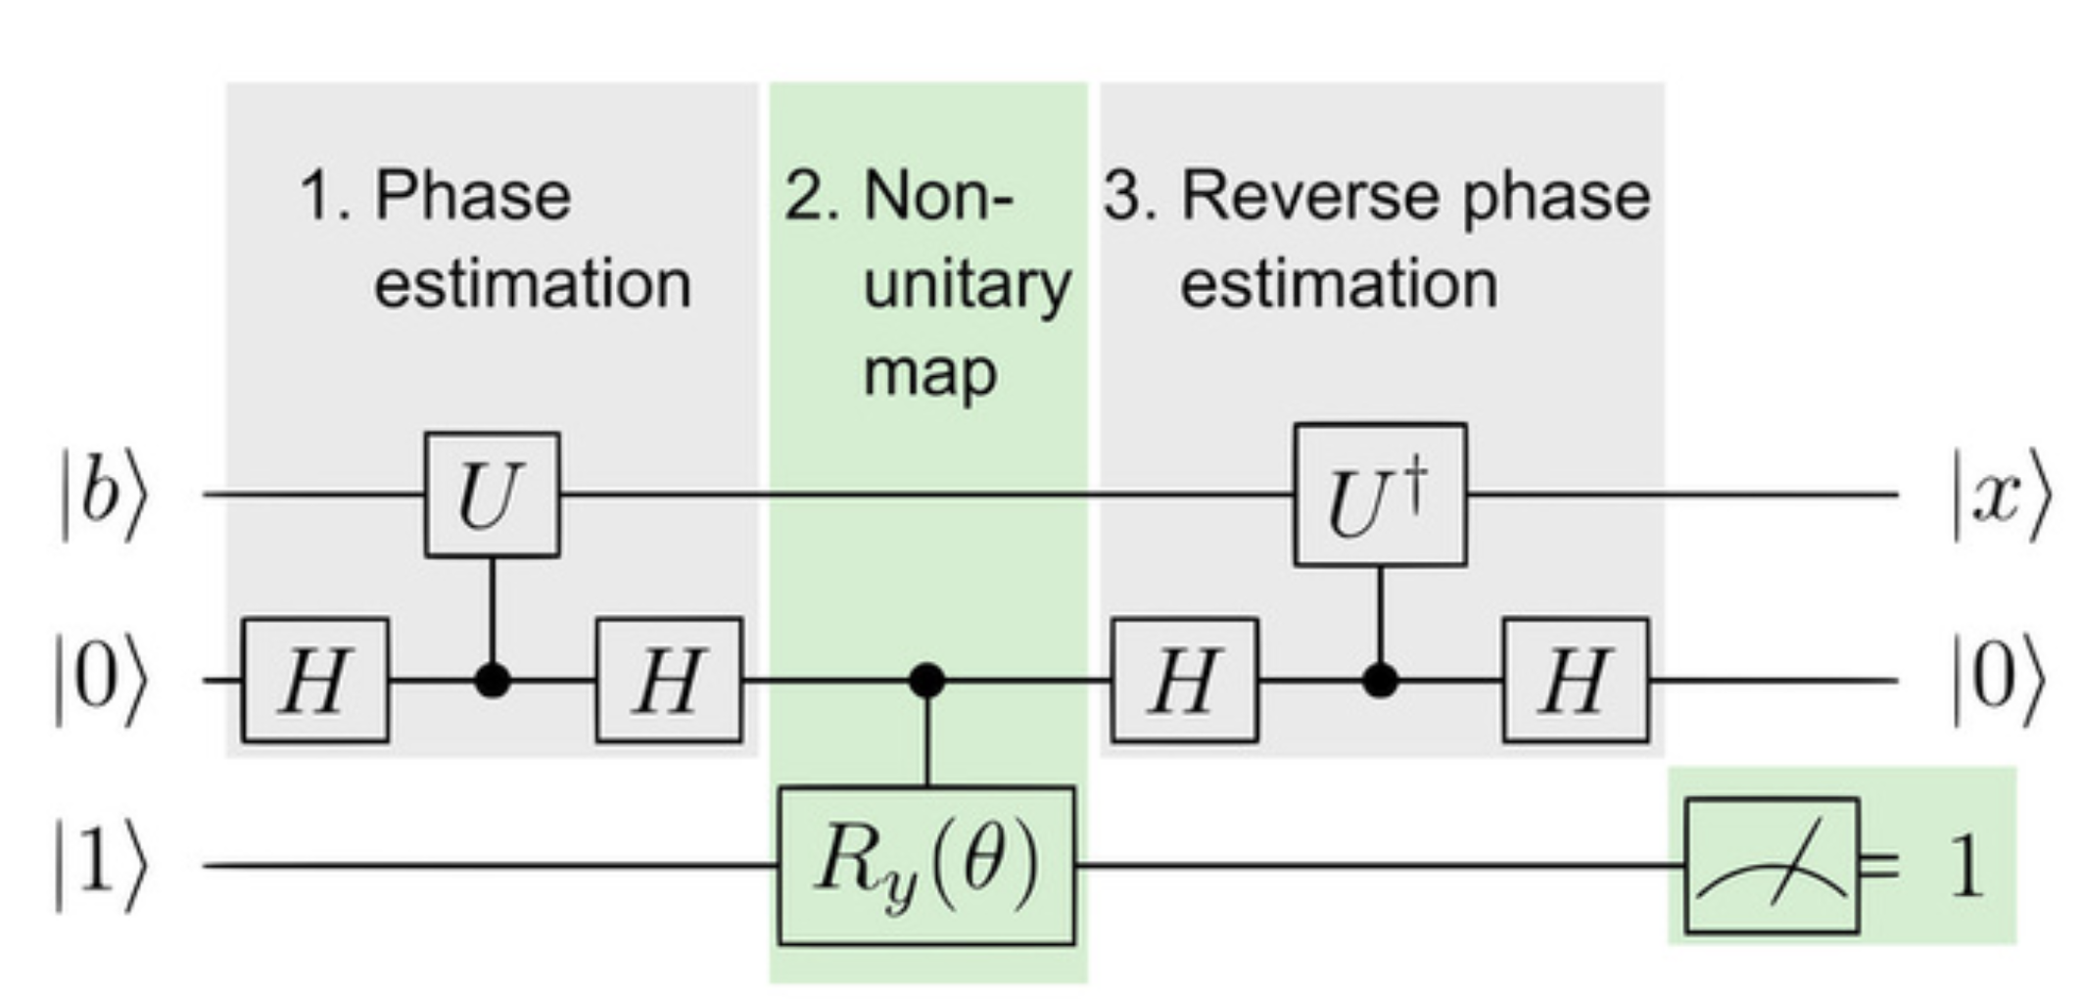
Recap: QLSA

Slide 4
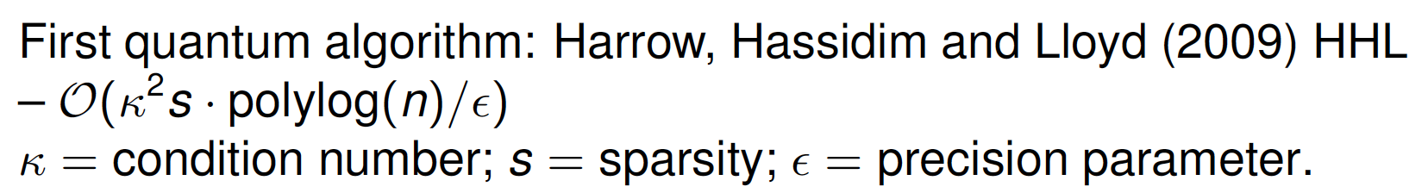
Potential catches:
State preparation
Solution readout
Sparsity dependence
Conditioning

Slide 5
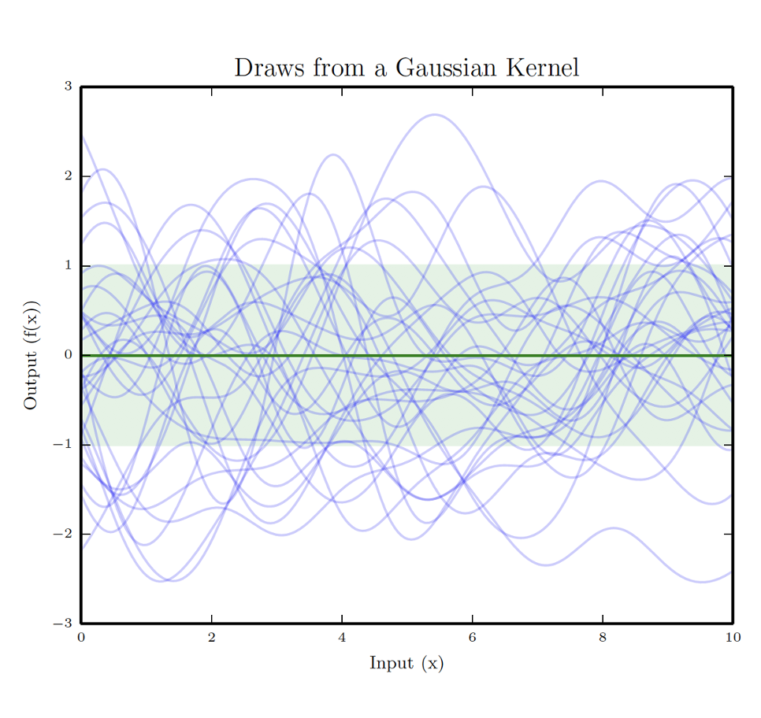
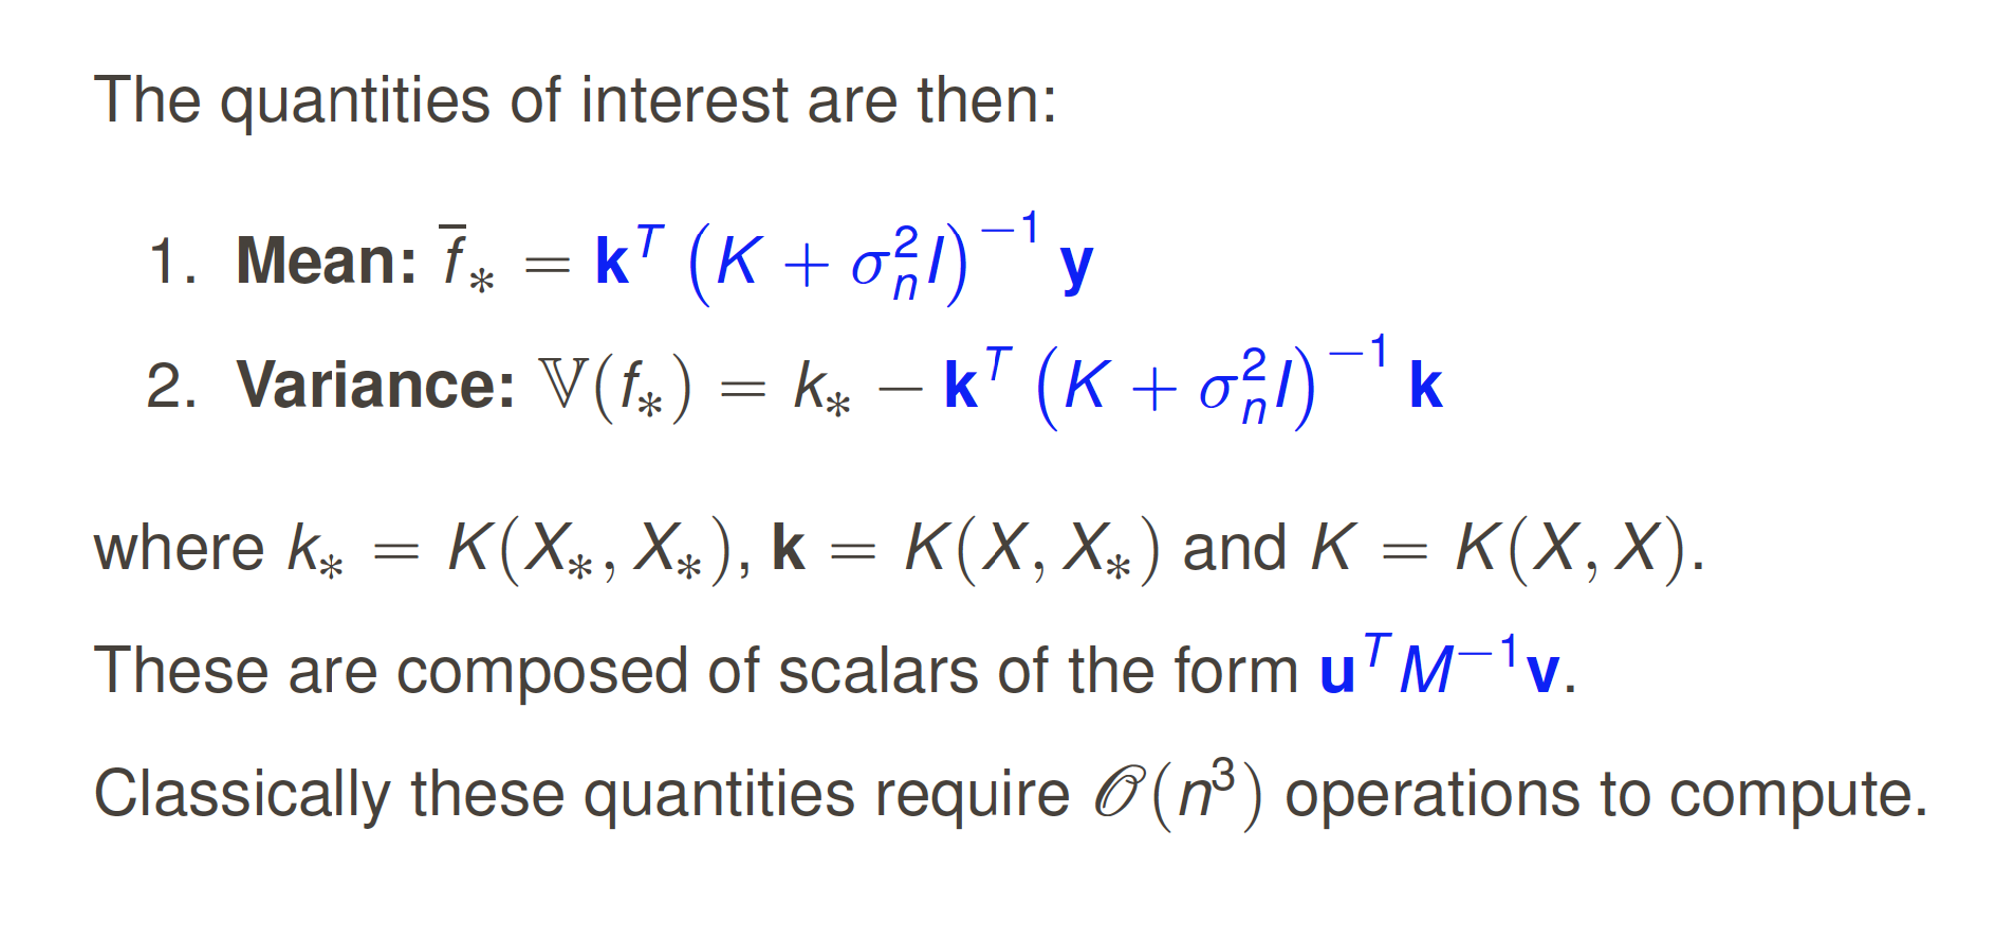
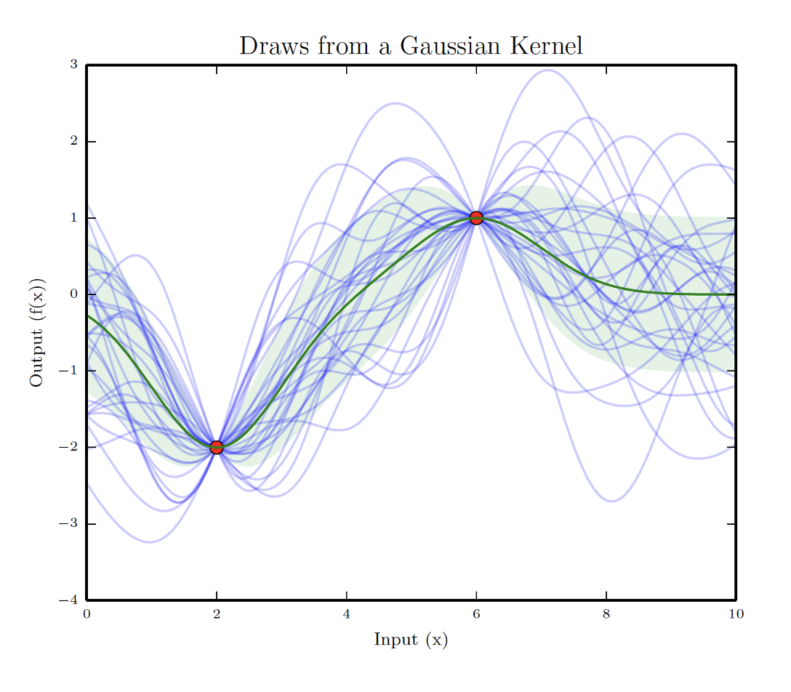
Recap: GP regression

Slide 6
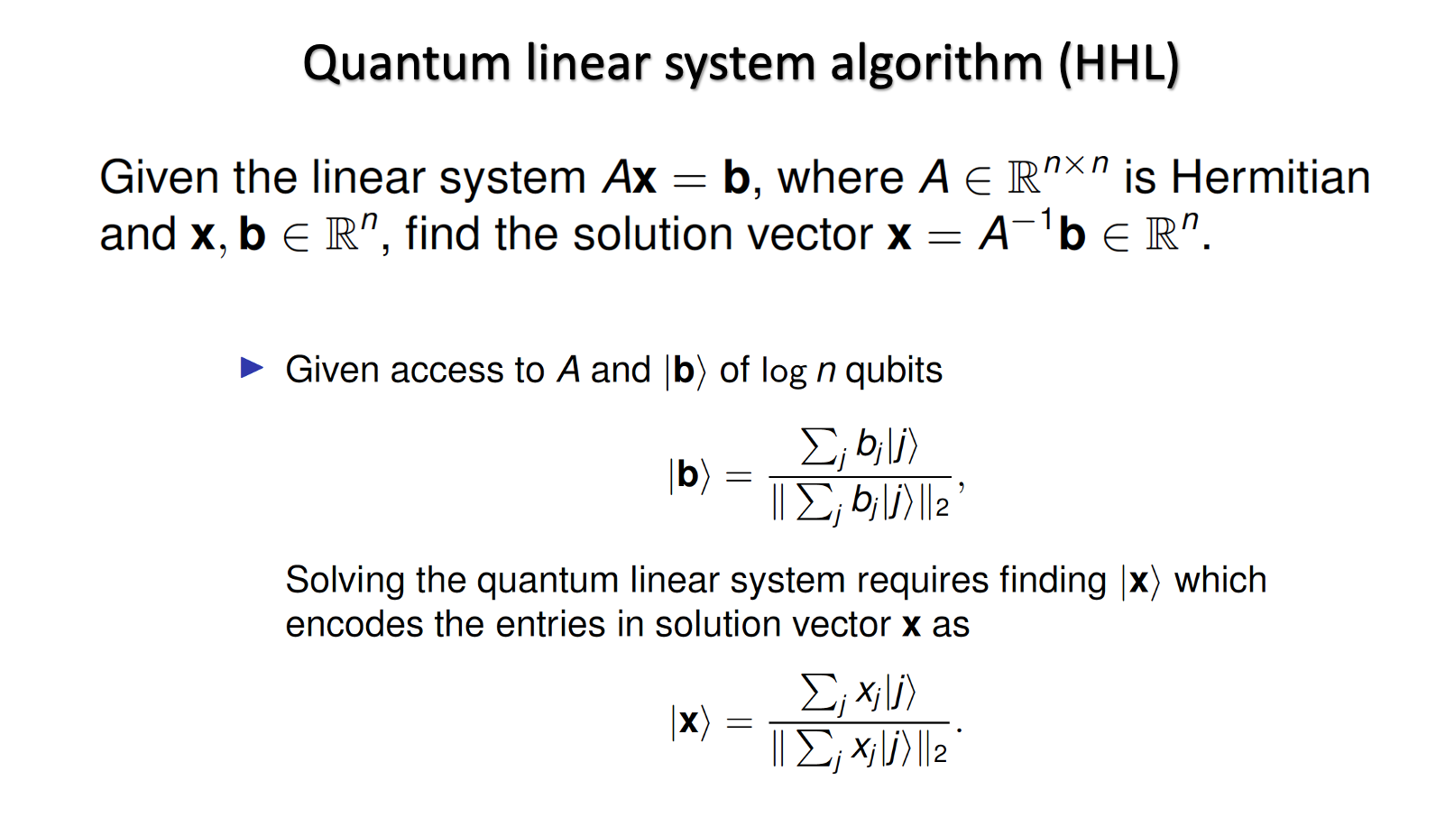
Recap: QLSA

Slide 7
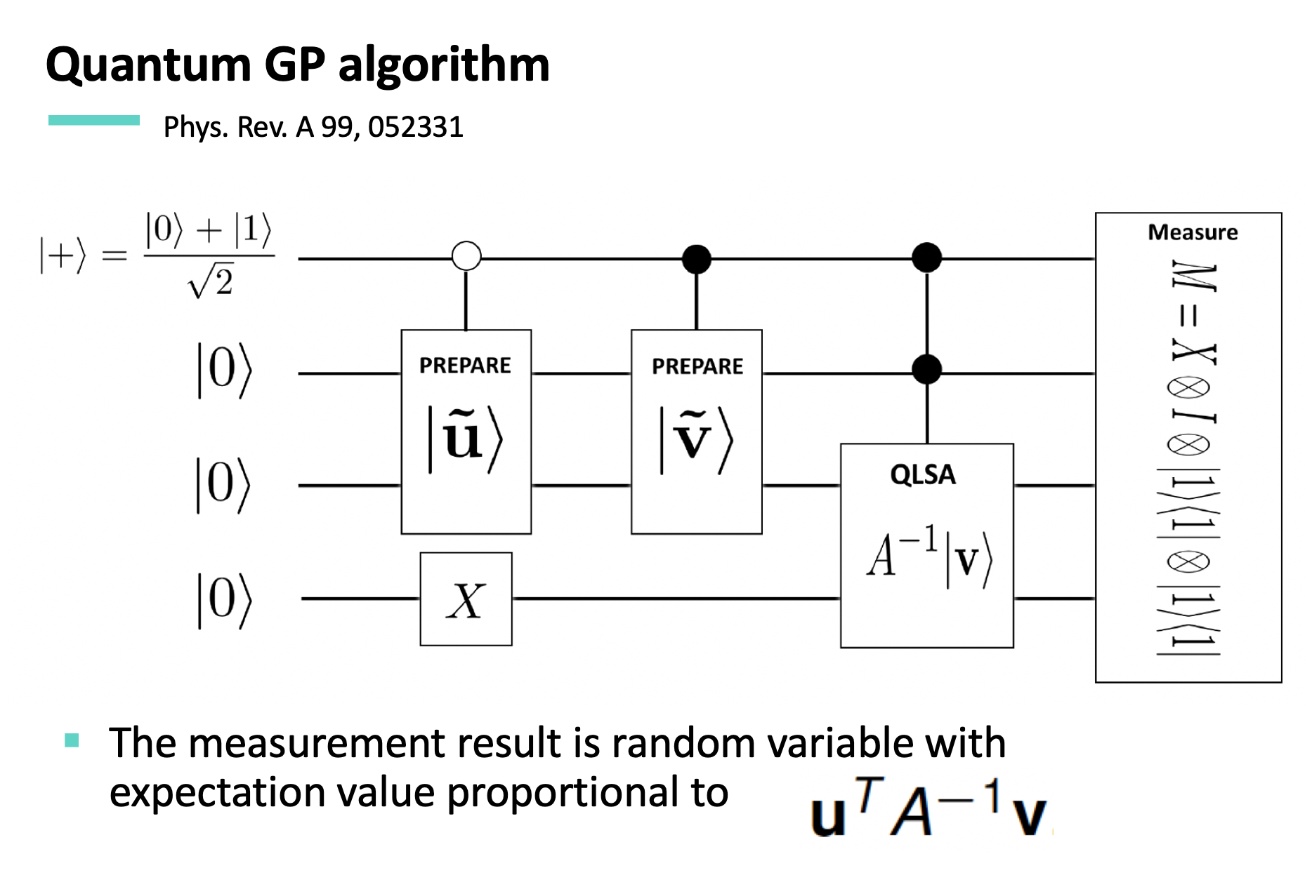

Slide 8
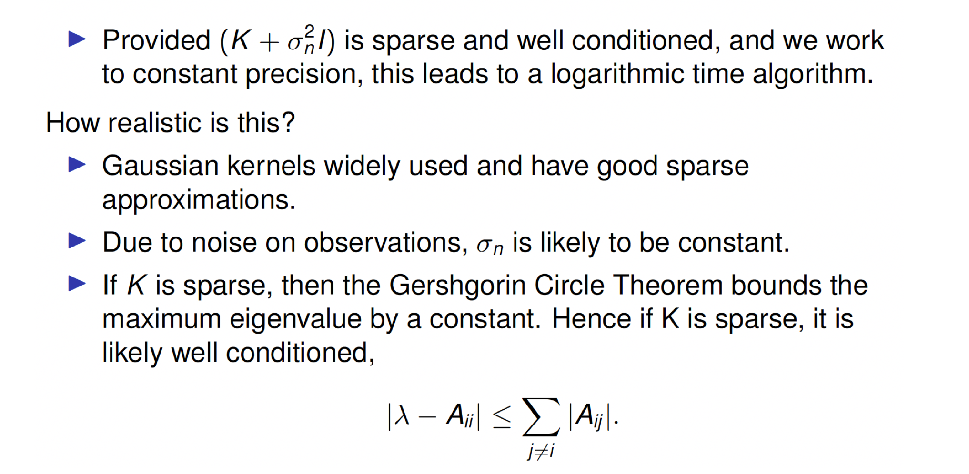
Quantum GP algorithm: Caveats examination
Application in material science: “Sparse quantum Gaussian processes to counter the curse of dimensionality” Quantum Machine Intelligence volume 3, Article number: 6 (2021)

Slide 9
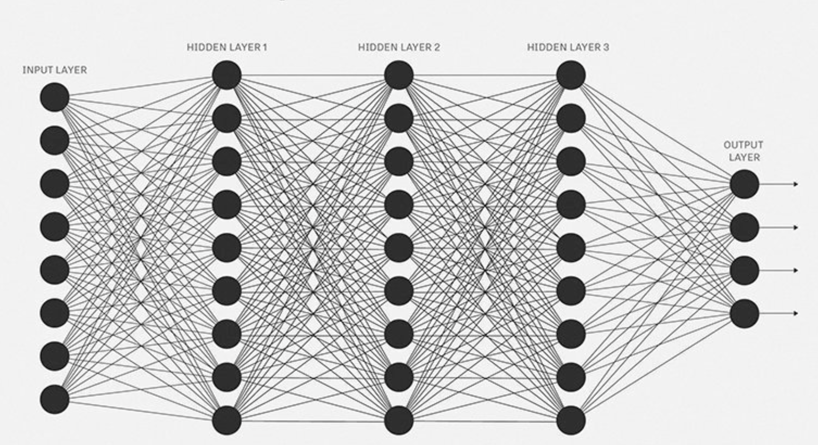
Infinite-width NN

Slide 10
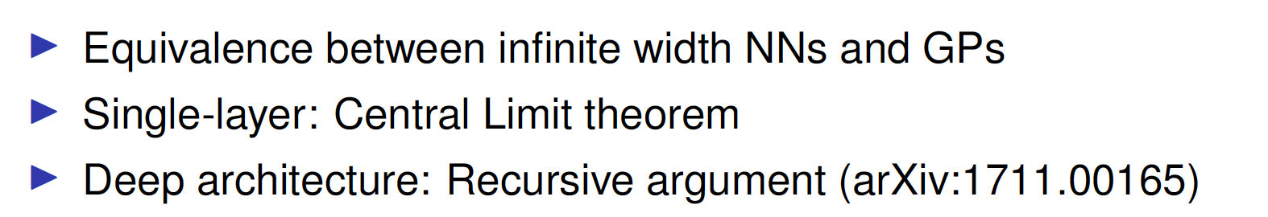
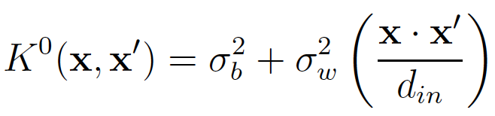

Slide 11
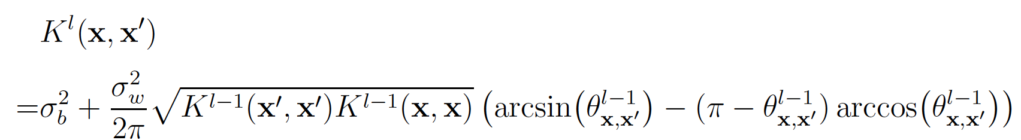
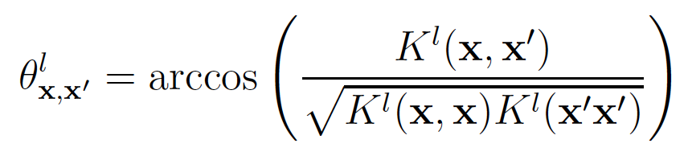
Computable case:
ReLU activation on every neurons, in which case we have an analytical expression for the covariance function:
This can be approximated with a polynomial series in the element-wise product, and diagonal outer products between the matrices

Slide 12
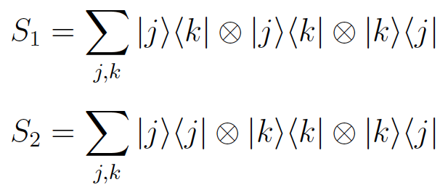
Hamiltonian simulation technique for element-wise computation:

Slide 13
More on State Preparation

Slide 14
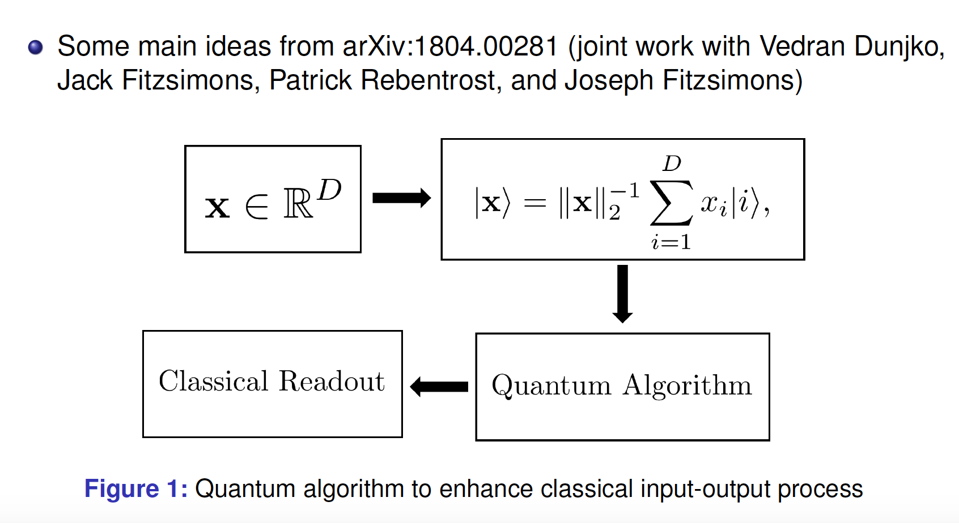
More on State preparation

Slide 15
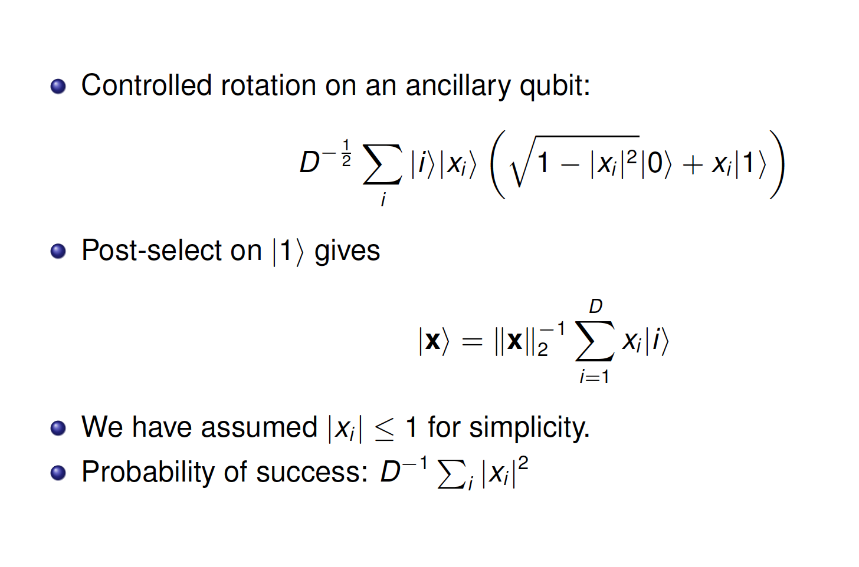
Amplitude encoding from oracle

Slide 16
Amplitude encoding from oracle

Slide 17
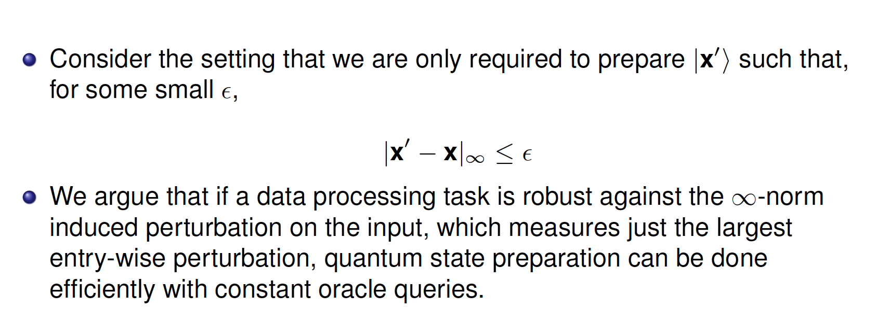
Alternative requirement

Slide 18
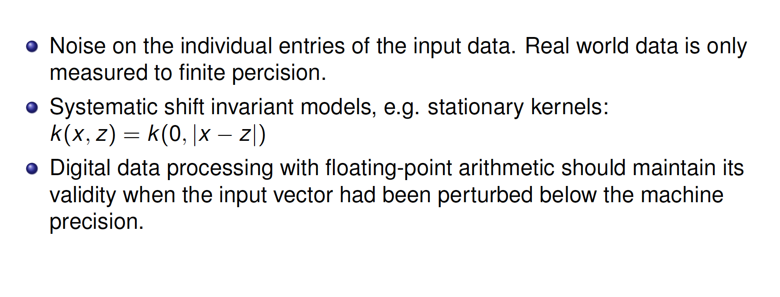

Practical relevance

Slide 19
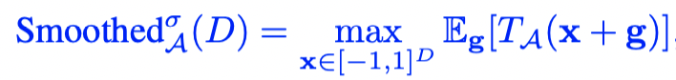
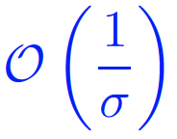
Smoothed complexity:
D. A. Spielman and S.-H. Teng, Communications of the ACM52, 76 (2009).
Intuition: A metric that interpolates between the performance of an algorithm on the random and worst-case datasets.
Originally to explain the efficiency of simplex algorithms, then generalized to a broader domain.
Smoothed complexity for oracle-based state preparation:
(Updates in progress for arXiv:1804.00281)

Slide 20

Ask me anything!

